Slide 1
Training Room Booking with Razorpay Integration
Spring Boot project
Done by,
Gnana Sarathy A
Jerry Oswin P

Slide 2
Project Description
A web application built on top of Spring Boot for training room booking with payment gateway implemented using Razorpay.
Web application consists of a dashboard showing the list of all training rooms with their details.
Status of the training room will be displayed in the next page by its availability.
If a training room is available, the user can enter the name and required hours to book a training room, If not, the user is notified that the current training room is occupied.
Once the user enters the details, the user can pay the total amount calculated based on the hours.
Once the payment is done using Razorpay the Training room will be allocated to the respective user.

Slide 3
Source Code of project:-
Github:-
https://bitbucket.org/gnana_sarathy/sirius-2022/src/master/

Slide 4
Project Demo Link
Video Link:-
https://drive.google.com/drive/folders/1Tr6gKVwDJvWmYznlmey9WOm8tQagSs_d?usp=sharing

Slide 5
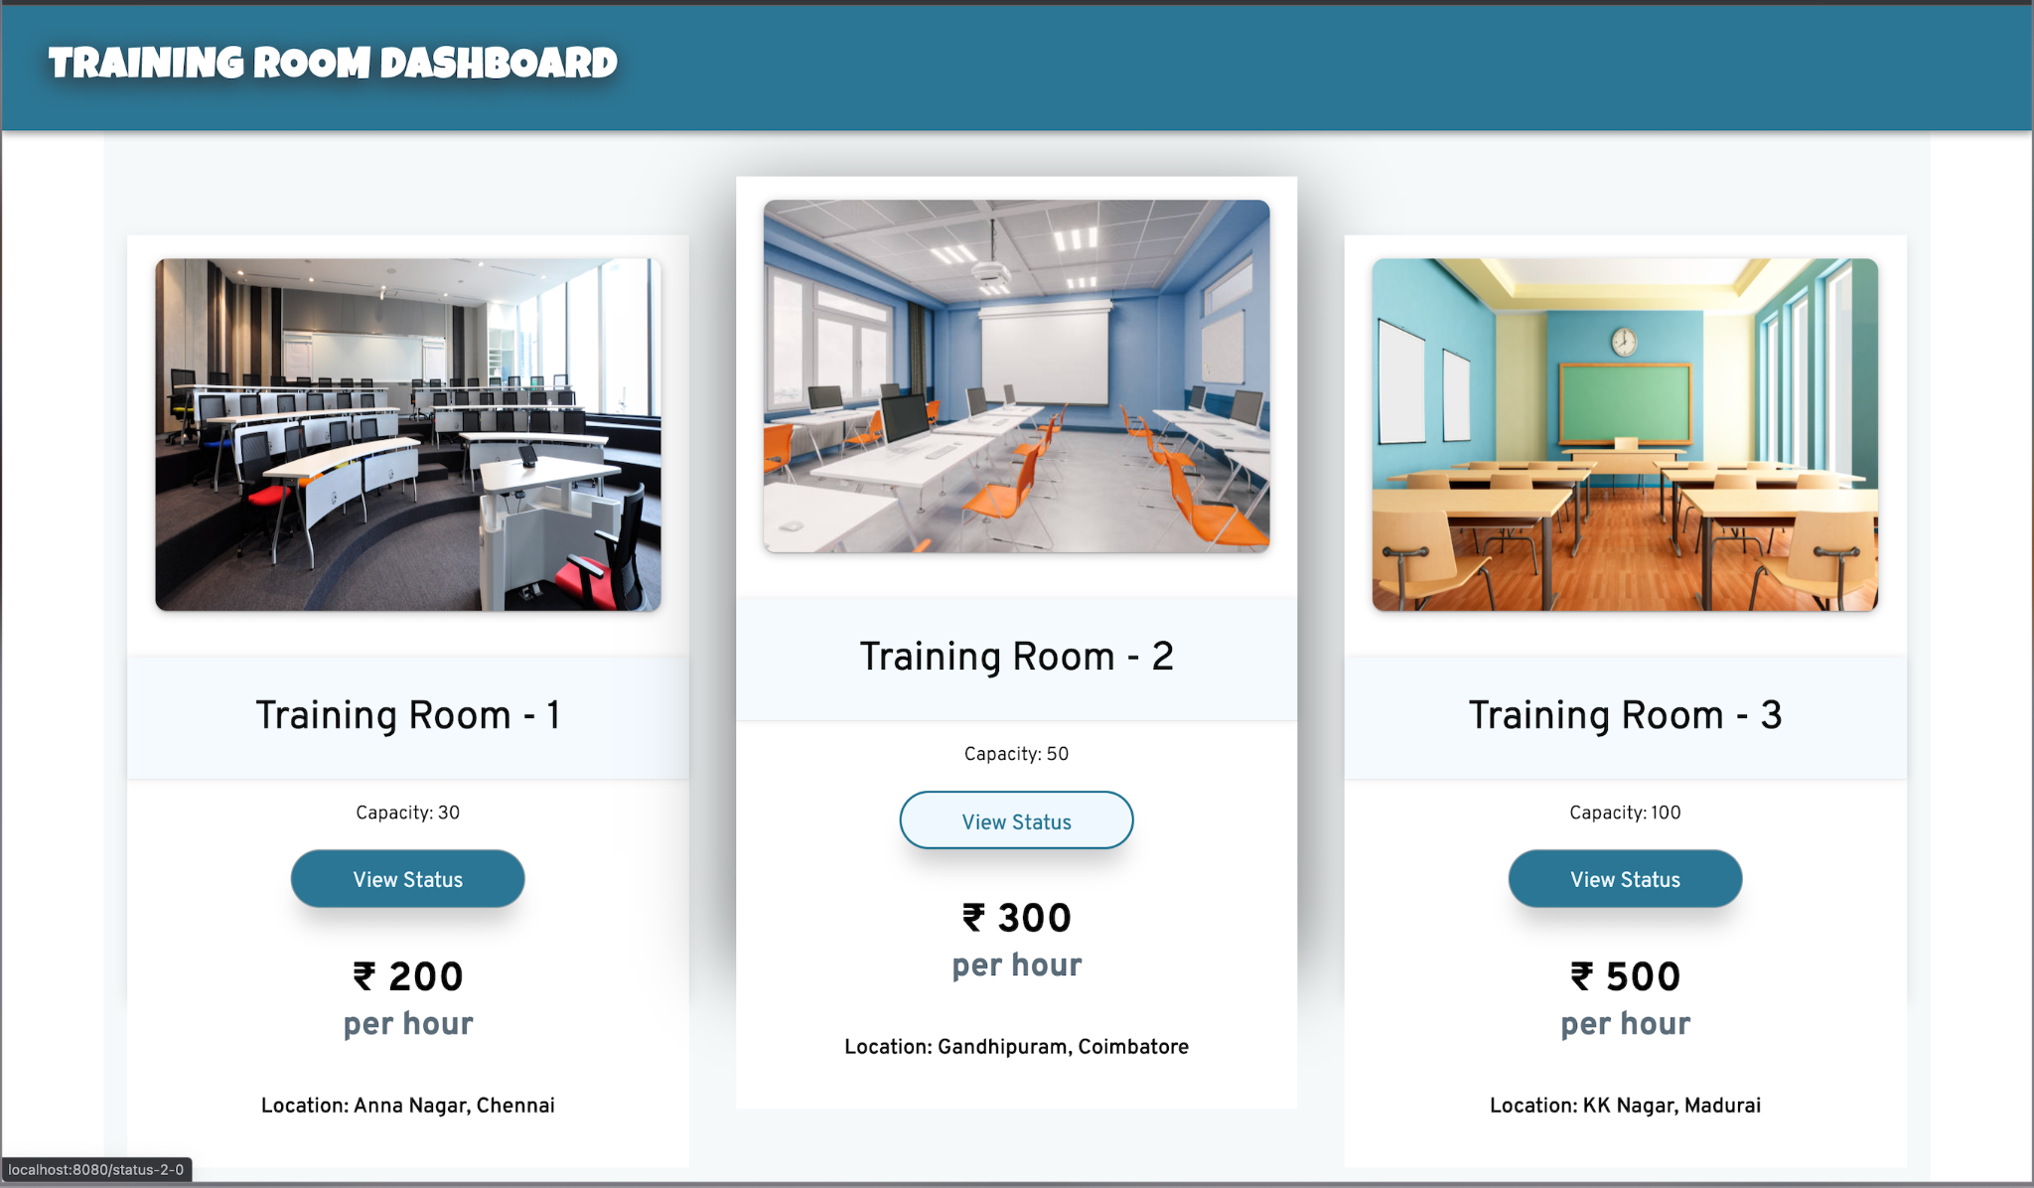
Project Demo Screenshots
Dashboard

Slide 6
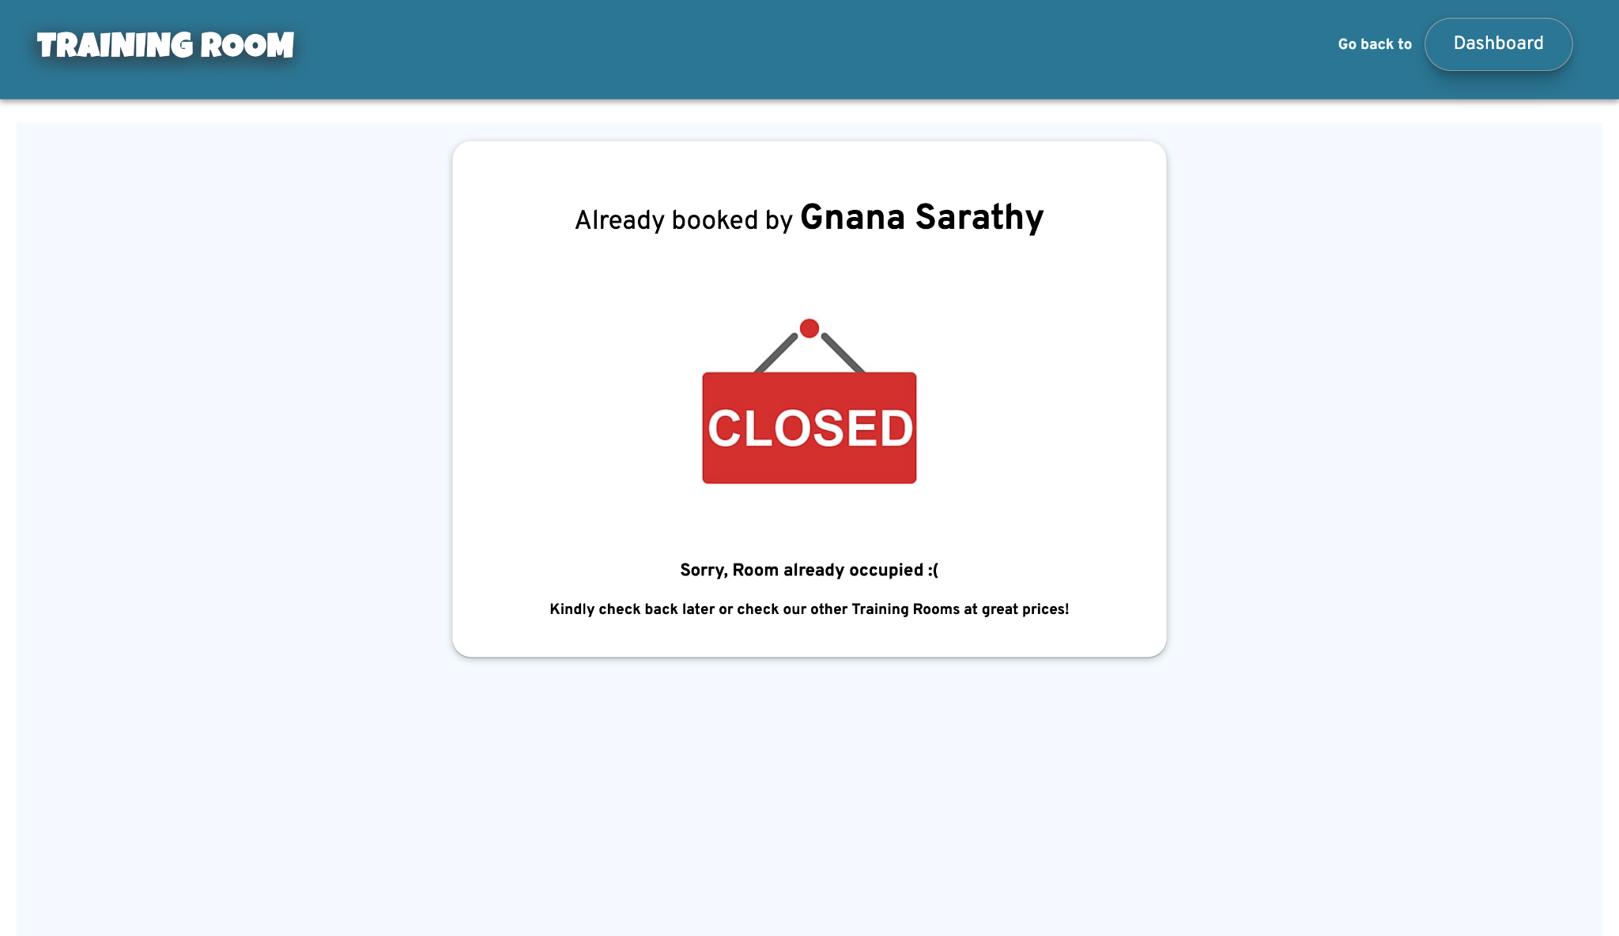
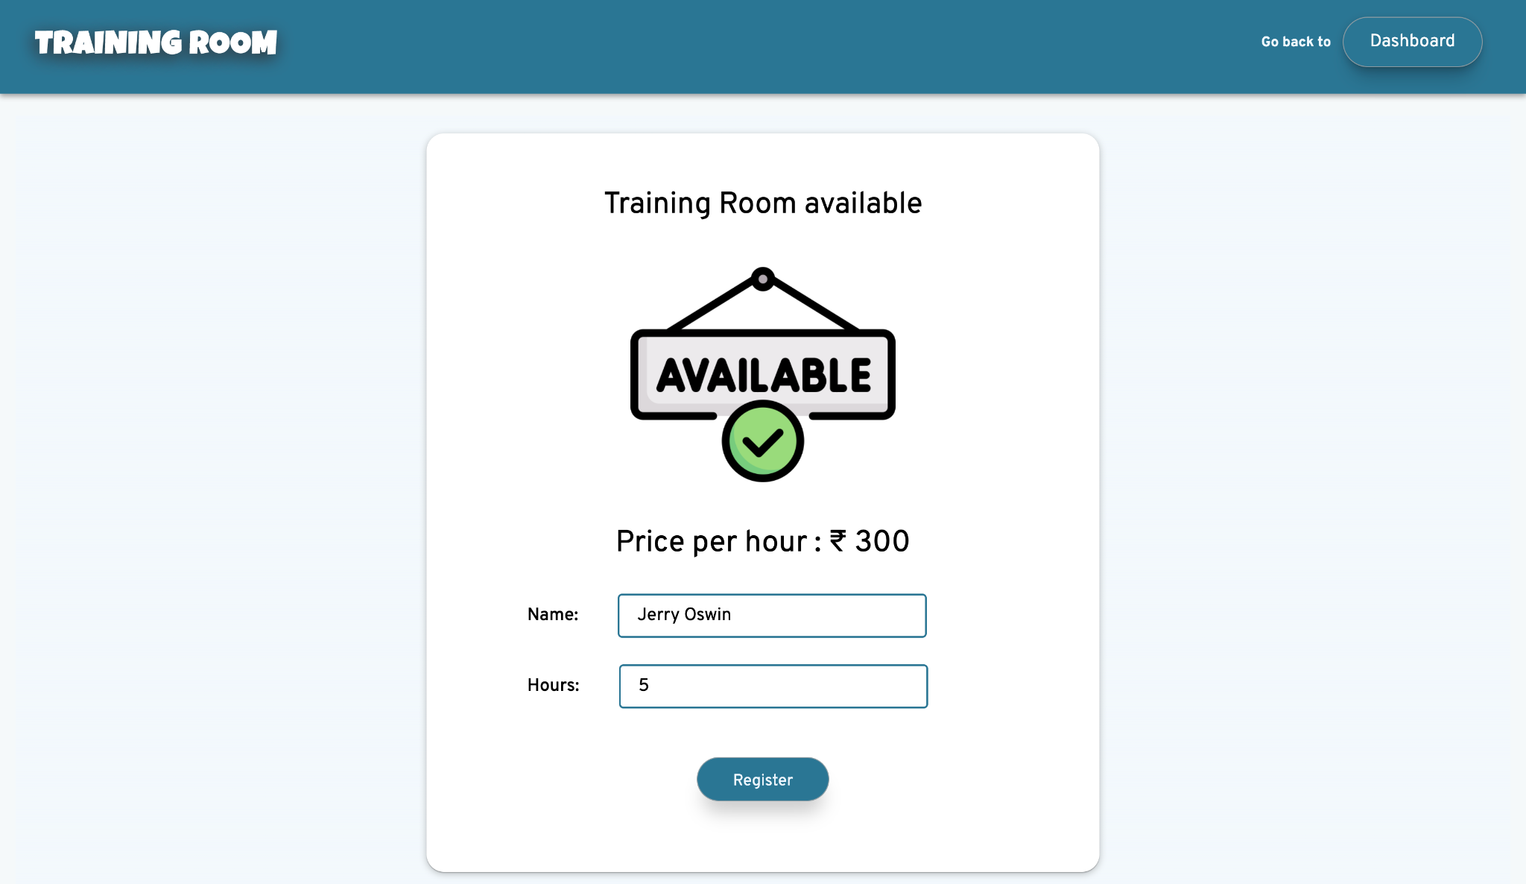
Training Room Status

Slide 7
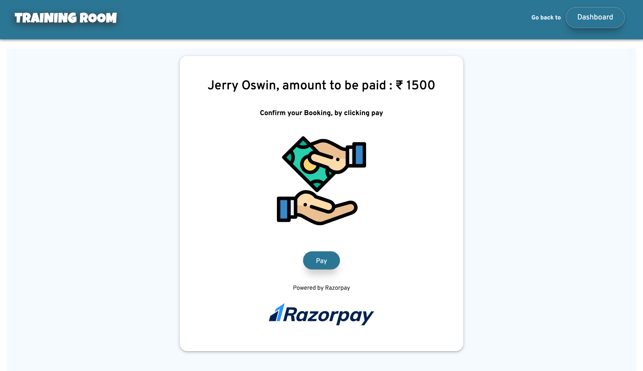
Payment Confirmation

Slide 8
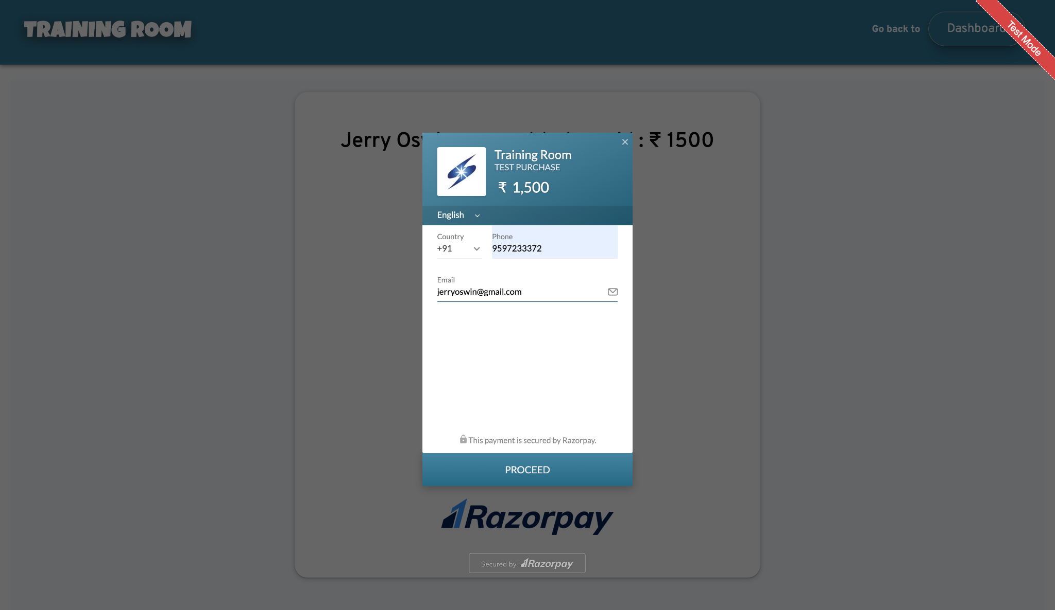
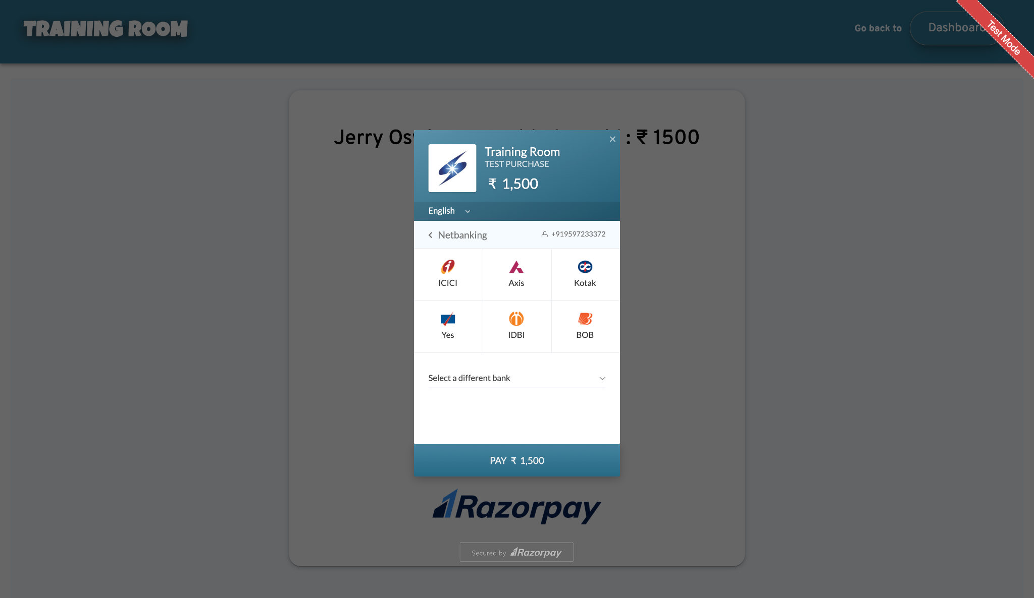
Payment Process

Slide 9
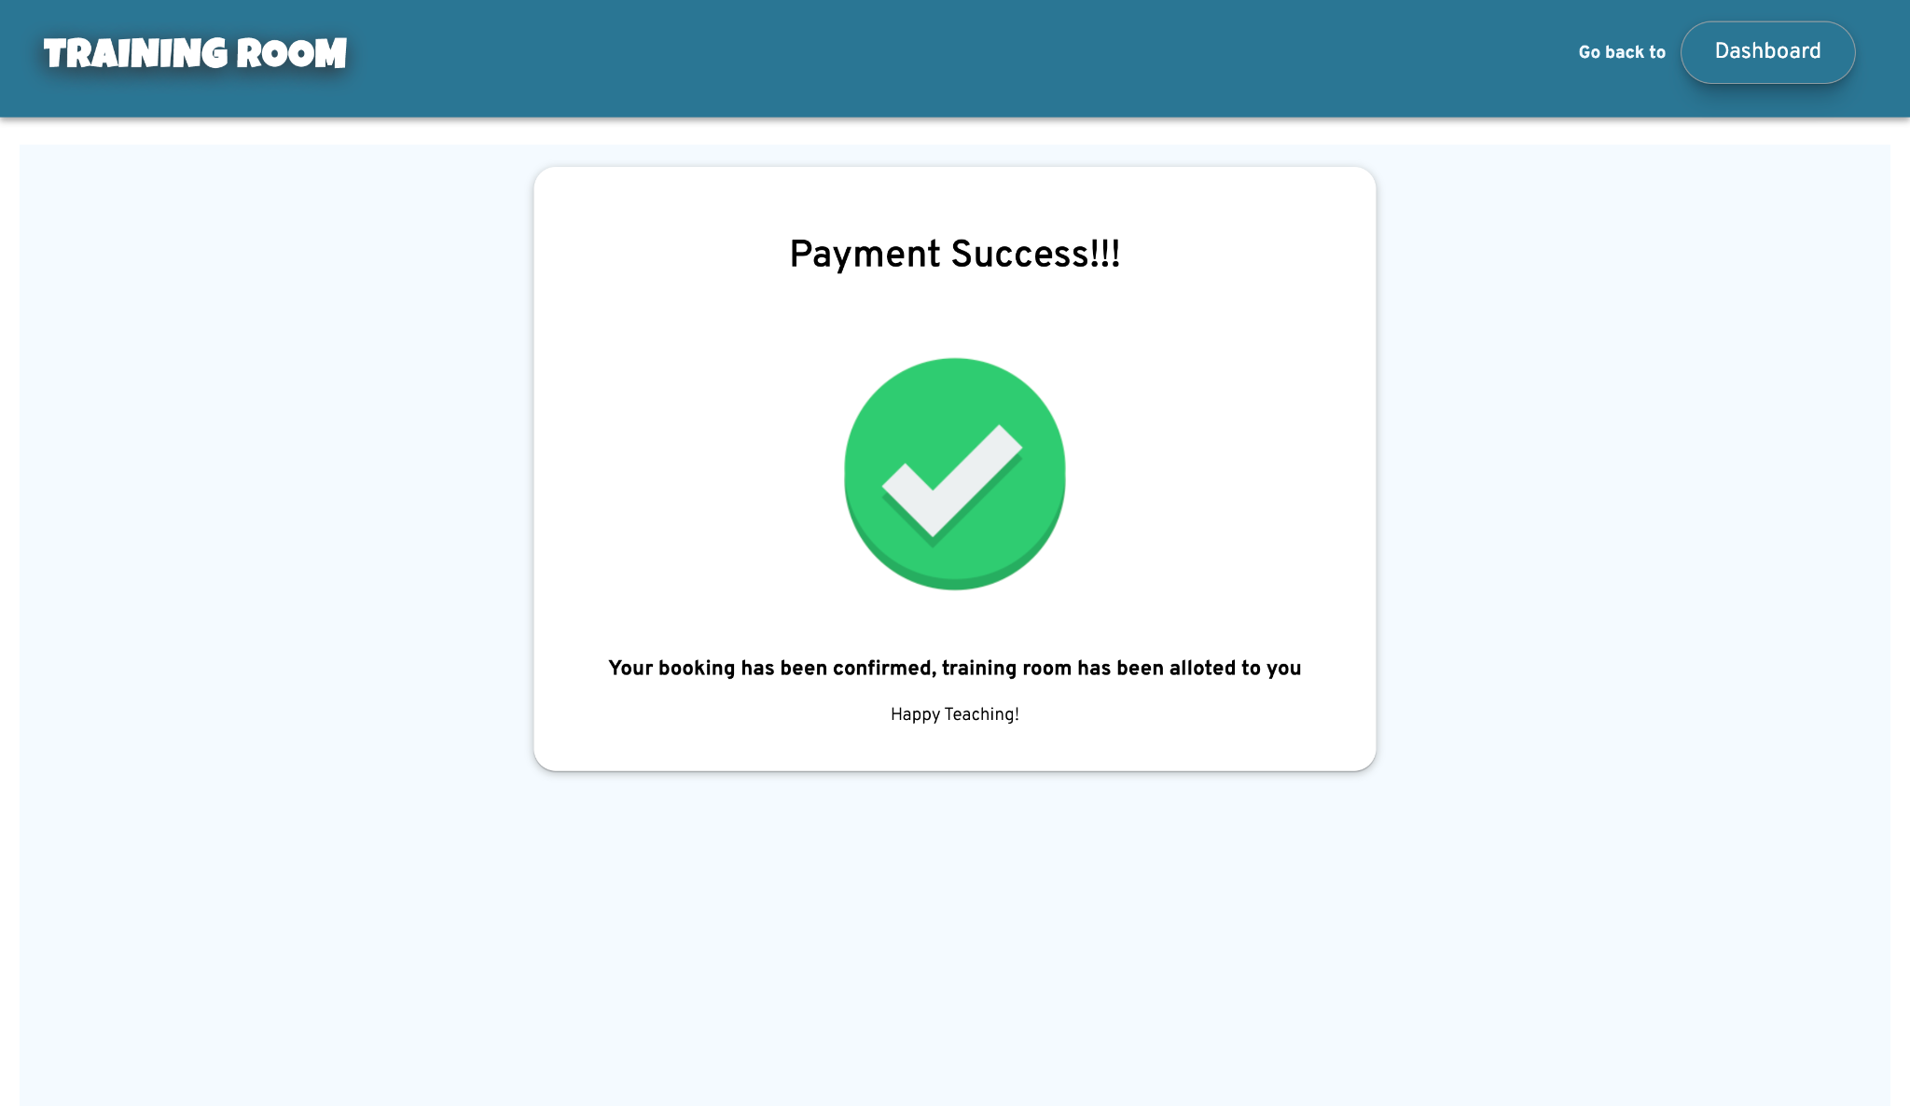
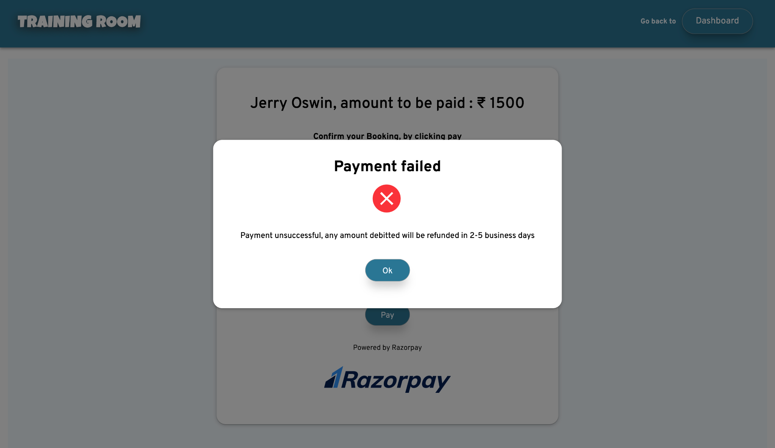
Payment Status

Slide 10
THANK YOU

